Slide 1

Programming and Data Structures
Debasis Samanta
Computer Science & Engineering
Indian Institute of Technology Kharagpur
Spring-2017

Slide 2
Lecture #6
Recursion in C

Slide 3
Today’s Discussion…
What is Recursion?
Some Examples
Recursion - Mechanism of Execution
Recursion versus Iteration
Function Call Implementation

Slide 4
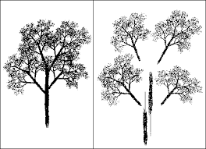
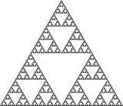
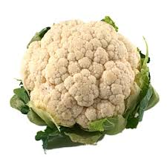
Concept of Recursion

Slide 5
Recursion
A process by which a function calls itself repeatedly.
  Such a function is called a recursive function
Recursion may be direct or cyclically in a chain
  Direct recursion.
    When a function f(…) calls f(…).
  Cyclically in a chain recursion.
    f1(…) calls f2(…) , f2(…) calls f3(…) . . . fi(…) calls f1(…)

Slide 6
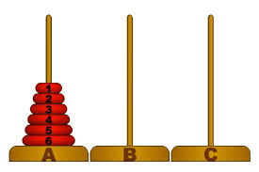
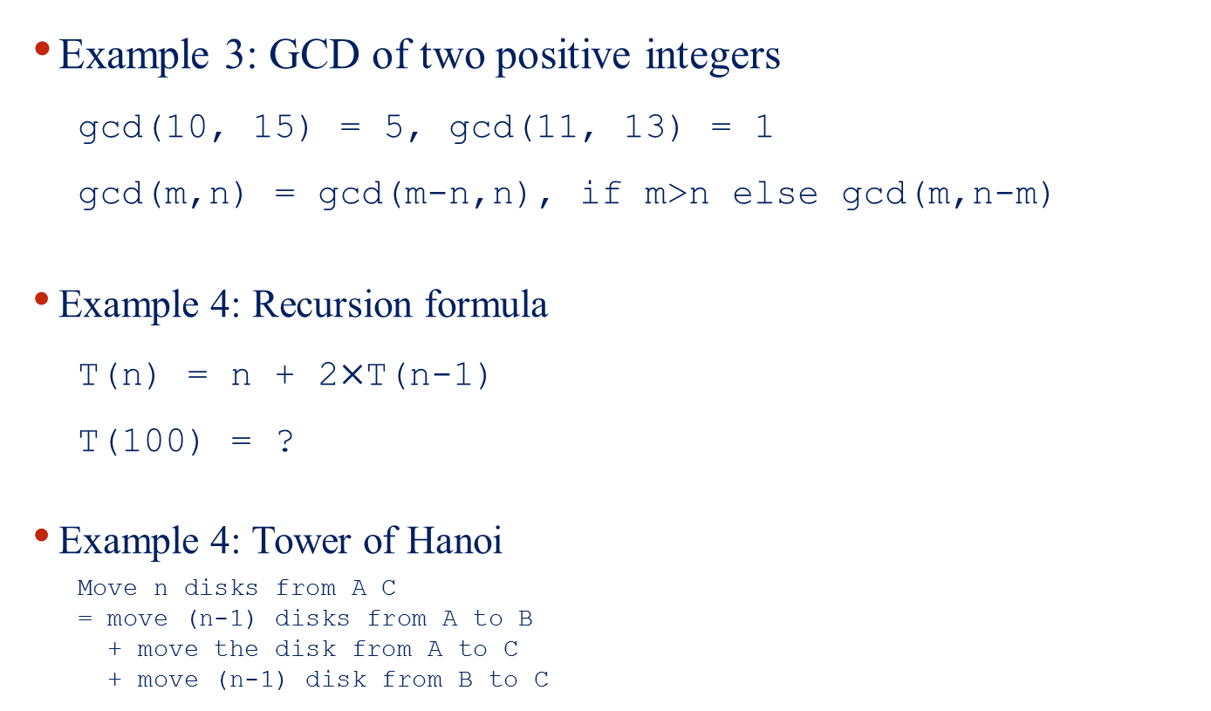
Some Examples of Recursion
Example 3: GCD of two positive integers
  gcd(10, 15) = 5, gcd(11, 13) = 1
  gcd(m,n) = gcd(m-n,n), if m>n else gcd(m,n-m)
Example 4: Recursion formula
  T(n) = n + 2$×$T(n-1)
  T(100) = ?
Example 4: Tower of Hanoi
  Move n disks from A C
  = move (n-1) disks from A to B
  + move the disk from A to C
  + move (n-1) disk from B to C

Slide 7
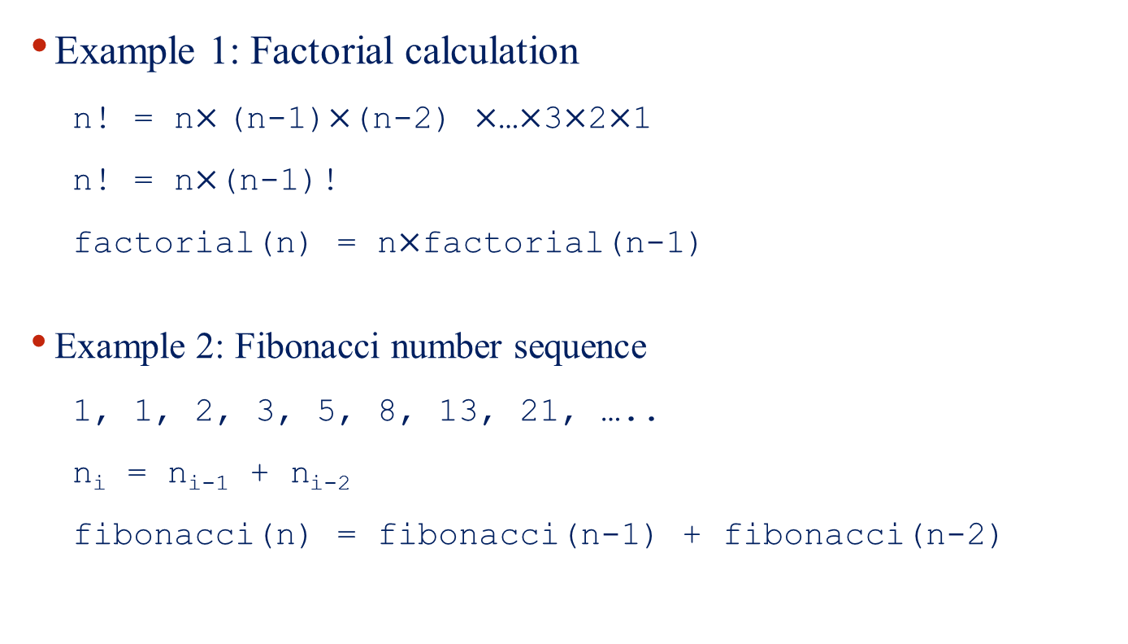
Some Examples of Recursion
Example 1: Factorial calculation
  n! = n$×$(n-1)$×$(n-2) $×$…$×$3$×$2$×$1
  n! = n$×$(n-1)!
  factorial(n) = n$×$factorial(n-1)
Example 2: Fibonacci number sequence
  1, 1, 2, 3, 5, 8, 13, 21, …..
  n_{i} = n_{i-1} + n_{i-2}
  fibonacci(n) = fibonacci(n-1) + fibonacci(n-2)

Slide 8
Important Points to be Noted
For a function to be written in recursive form, two conditions are to be satisfied:
  Condition 1
    It should be possible to express the problem in recursive form.
  Condition 2
    The problem statement must include a stopping condition.

Slide 9
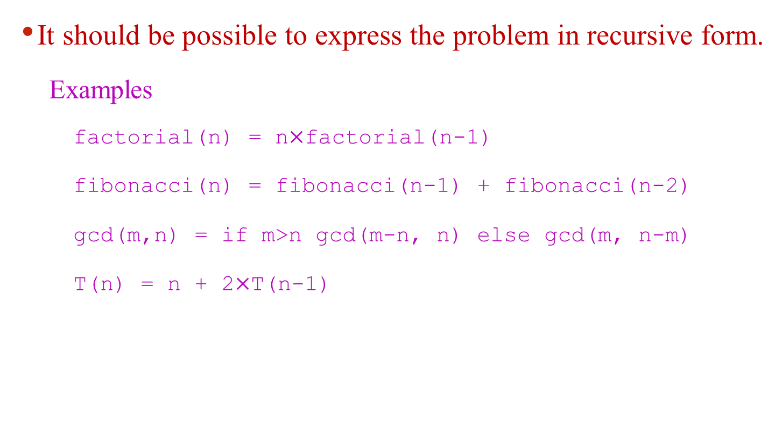
Important Points to be Noted
It should be possible to express the problem in recursive form.
  Examples
    factorial(n) = n$×$factorial(n-1)
    fibonacci(n) = fibonacci(n-1) + fibonacci(n-2)
    gcd(m,n) = if m>n gcd(m-n, n) else gcd(m, n-m)
    T(n) = n + 2$×$T(n-1)

Slide 10
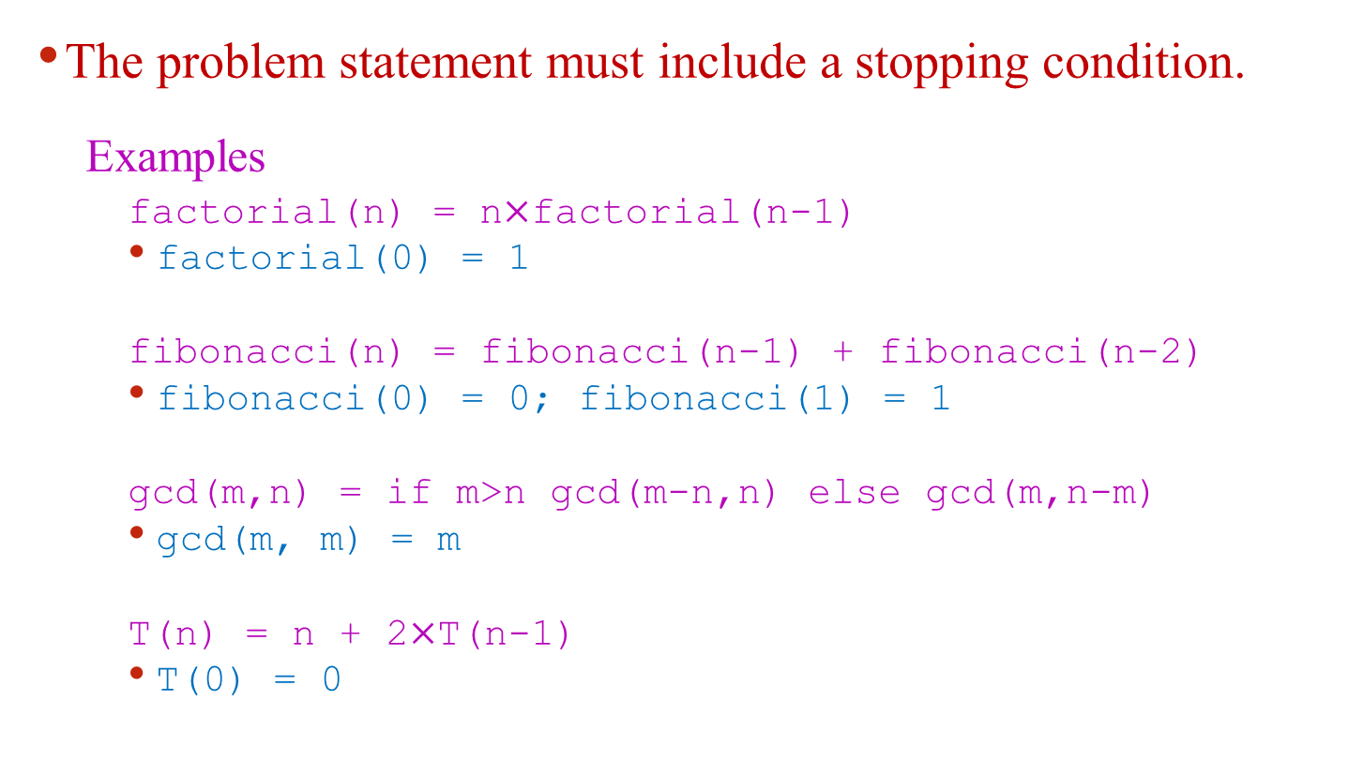
Important Points to be Noted
The problem statement must include a stopping condition.
  Examples
    factorial(n) = n$×$factorial(n-1)
    factorial(0) = 1
    fibonacci(n) = fibonacci(n-1) + fibonacci(n-2)
    fibonacci(0) = 0; fibonacci(1) = 1
    gcd(m,n) = if m>n gcd(m-n,n) else gcd(m,n-m)
    gcd(m, m) = m
    T(n) = n + 2$×$T(n-1)
    T(0) = 0

Slide 11
Some Examples of Recursion

Slide 12
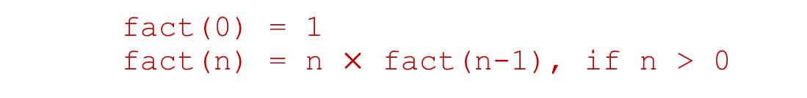
Recursive Function for n!
    fact(0) = 1
    fact(n) = n $×$ fact(n-1), if n > 0
#include <stdio.h>
int fact(int n)
{
    if (n == 0)
    return 1;
    else
    return (n * fact(n-1));
}
void main()
{
    int x;
    scanf(“%d”, &x);
    printf (“Factorial of %d is: %d”, x, fact(x));
}

Slide 13
Factorial Execution
When a recursive program is executed, the recursive function calls are not executed immediately.
They are kept aside (on a stack) until the stopping condition is encountered.
The function calls are then executed in reverse order.

Slide 14
Factorial Execution
fact(4)
24
if (4 = = 0) return (1);
else return (4 * fact(3));
6
if (3 = = 0) return (1);
else return (3 * fact(2));
2
if (2 = = 0) return (1);
else return (2 * fact(1));
1
int fact (int n)
{
if (n = = 0) return (1);
else return (n * fact(n-1));
}
if (1 = = 0) return (1);
else return (1 * fact(0));

Slide 15
Factorial Execution
First, the function calls will be processed
fact(4) = 4 * fact(3)
fact(3) = 3 * fact(2)
fact(2) = 2 * fact(1)
fact(1) = 1 * fact(0)
The actual values return in the reverse order
fact(0) = 1
fact(1) = 1 * 1 = 1
fact(2) = 2 * 1 = 2
fact(3) = 3 * 2 = 6
fact(4) = 4 * 6 = 24

Slide 16
Recursive Function for F(n)
    fibo(0) = 0; fibo(1) = 1
    fibo(n) = fibo(n-1) + fibo(n-2), if n > 2
#include <stdio.h>
int fibo(int n)
{
    if (n < 2)
    return n;
    else
    return (fibo(n-1) + fibo(n-2));
}
void main()
{
int x;
scanf(“%d”, &x);
printf (“%d-th Fibonacci number is %d \n”, x, fibo(x));
}

Slide 17
Fibonacci Series Execution
int f(int n)
{
  if (n < 2)
  return (n);
  else
  return (f(n-1) + f(n-2));
}
f(0) = 0
f(1) = 1
f(n) = f(n-1)+f(n-2),if n>1
f(4)
f(3)
f(2)
f(2)
f(1)
f(1)
f(0)
f(1)
f(0)

Slide 18
Tracing Execution
How many times is the function called when evaluating f(4) ?
Inefficiency:
  Same thing is computed several times.
f(4)
f(3)
f(2)
f(2)
f(1)
f(1)
f(0)
f(1)
f(0)
called 9 times

Slide 19
Recursive Function for gcd(m,n)
    gcd(m,m) = m;
    gcd(m,n) = gcd(m-n, n) if m > n
    = gcd(m, n-m) else
#include <stdio.h>
int gcd(int m, int n)
{
    if (m == n)
    return m;
    else
    if (m > n) return (gcd(m-n, n);
    else return gcd(m, n-m);
}
void main()
{
int x, y;
scanf(“x = %d, y = %d”, &x, &y);
printf (“GCD of %d and %d is %d”, x, y, gcd(x, y));
}

Slide 20
GCD Execution
gcd(m,m) = m;
gcd(m,n) = gcd(m-n, n) if m > n
= gcd(m, n-m) else
int gcd(int m, int n)
{
if (m == n)
return m;
else
if(m > n) return (gcd(m-n,n);
else return gcd(m, n-m);
}
g(10,15)
g(10, 5)
g(5,5)

Slide 21
Performance Comparison of GCDs
gcd(m,n) = m, if m = n
= gcd(m-n,n) if m>n
= gcd(m,n-m) else
gcd(m,n) = m, if (m = n) or n = 0;
= gcd(n,m) if n>m
= gcd(m%n,m)
int gcd(int m, int n)
{
if (m == n)
return m;
else
if(m > n) return (gcd(m-n,n);
else return gcd(m, n-m);
}
int gcd(int m, int n)
{
if ((m == n)|| (n == 0))
return m;
else
if(n > m) return (gcd(n,m);
else return gcd(m, n%m);
}
Compare the performance of the above-mentioned two versions of gcd calculations

Slide 22

Recursive Function for T(n)
    T(0) = 0
    T(n) = n $+$ 2 $×$T(n-1), if n > 0
#include <stdio.h>
int T(int n)
{
    if (n == 0)
    return 0;
    else
    return (n + 2*T(n-1));
}
void main()
{
    int x;
    scanf(“%d”, &x);
    printf (“T(%d”)= %d”, x, T(x));
}

Slide 23
Towers of Hanoi Problem
1
2
3
4
5
A
B
C

Slide 24
Towers of Hanoi Problem
The problem statement
  Initially all the disks are stacked on the A pole.
  Required to transfer all the disks to the C pole.
    Only one disk can be moved at a time.
    A larger disk cannot be placed on a smaller disk.
  C pole is used for temporary storage of disks.

Slide 25
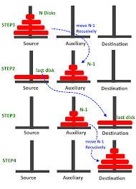
Towers of Hanoi Problem
Recursive statement of the general problem of n disks
  Step 1:
    Move the top (n-1) disks from A to B
  Step 2:
    Move the largest disk from A to C.
  Step 3:
    Move the (n-1) disks from B to C.

Slide 26
Towers of Hanoi Problem
#include <stdio.h>
void move(int n, char A, char B, char C);
int main()
{
  int n; /* Number of disks */
  scanf (“%d”, &n);
  move (n, ‘A’, ‘B’, ‘C’);
  return 0;
}
void move (int n, char A, char B, char C)
{
if (n > 0) {
        move (n-1, A, C, B);
        printf (“Move disk %d from %c to %c \n”, n, A, C);
        move (n-1, B, C, A);
        }
return;
}

Slide 27
Towers of Hanoi – Execution
3
Move disk 1 from A to C
Move disk 2 from A to B
Move disk 1 from C to B
Move disk 3 from A to C
Move disk 1 from B to A
Move disk 2 from B to C
Move disk 1 from A to C
4
Move disk 1 from A to B
Move disk 2 from A to C
Move disk 1 from B to R
Move disk 3 from A to B
Move disk 1 from C to L
Move disk 2 from C to B
Move disk 1 from A to B
Move disk 4 from A to C
Move disk 1 from B to C
Move disk 2 from B to A
Move disk 1 from C to A
Move disk 3 from B to C
Move disk 1 from A to B
Move disk 2 from A to C
Move disk 1 from B to C
5
Move disk 1 from A to C
Move disk 2 from A to B
Move disk 1 from C to B
Move disk 3 from A to C
Move disk 1 from B to A
Move disk 2 from B to C
Move disk 1 from A to C
Move disk 4 from A to B
Move disk 1 from C to B
Move disk 2 from C to A
Move disk 1 from B to A
Move disk 3 from C to B
Move disk 1 from A to C
Move disk 2 from A to B
Move disk 1 from C to B
Move disk 5 from A to C
Move disk 1 from B to A
Move disk 2 from B to C
Move disk 1 from A to C
Move disk 3 from B to A
Move disk 1 from C to B
Move disk 2 from C to A
Move disk 1 from B to A
Move disk 4 from B to C
Move disk 1 from A to C
Move disk 2 from A to B
Move disk 1 from C to B
Move disk 3 from A to C
Move disk 1 from B to A
Move disk 2 from B to C
Move disk 1 from A to C
How many moves are
required for n disks?

Slide 28
Points to be Noted
Every recursive program can also be written without recursion.
Recursion is used for programming convenience, not for performance enhancement.
Sometimes, if the function being computed has a nice recurrence form, then a recursive code may be more readable.
Performance warning!
Speed: Avoid Fibonacci-style recursive programs, which result in an exponential “explosion” of calls.
Memory: Recursive calls take consume additional memory.

Slide 29
Recursion Versus Iteration
Repetition
  Iteration: explicit loop
  Recursion: repeated function calls
Termination
  Iteration: Loop condition fails
  Recursion: Base case recognized
Both can have infinite loops
  Be careful about the termination condition
Balance
  Choice between performance (iteration) and good software engineering (recursion).

Slide 30
How are function calls implemented?
The following applies in general, with minor variations that are implementation dependent.
  The system maintains a stack in memory.
    Stack is a last-in first-out structure.
    Two operations on stack, push and pop.
  Whenever there is a function call, the activation record gets pushed into the stack.
    Activation record consists of the return address in the calling program, the return value from the function, and the local variables inside the function.

Slide 31
Function calls implementation
main()
{
……..
x = gcd (a, b);
……..
}
int gcd (int x, int y)
{
……..
……..
return (result);
}
Local
Variables
Activation record
STACK
Return Value
Return Addr
Before call
After call
After return

Slide 32
main()
{
……..
x = ncr (a, b);
……..
}
int ncr (int n, int r)
{
return (fact(n)/
fact(r)/fact(n-r));
}
int fact (int n)
{
………
return (result);
}
3 times
3 times
LV2, RV2, RA2
LV1, RV1, RA1
LV1, RV1, RA1
LV1, RV1, RA1
Before call
Call ncr
Call fact
fact returns
ncr returns

Slide 33
What happens for recursive calls?
What we have seen ….
  Activation record gets pushed into the stack when a function call is made.
  Activation record is popped off the stack when the function returns.
In recursion, a function calls itself.
  Several function calls going on, with none of the function calls returning back.
    Activation records are pushed onto the stack continuously.
    Large stack space required.
    Activation records keep popping off, when the termination condition of recursion is reached.

Slide 34
Example:: main() calls fact(3)
main()
{
int n;
n = 3;
printf (“%d \n”, fact(n) );
}
int fact (n)
int n;
{
if (n = = 0)
return (1);
else
return(n * fact(n-1));
}

Slide 35
TRACE OF THE STACK DURING EXECUTION
n = 0
1
RA .. fact
main calls fact
n = 1
n = 1
n = 1
fact returns to main
-
-
1*1 = 1
RA .. fact
RA .. fact
RA .. fact
n = 2
n = 2
n = 2
n = 2
n = 2
-
-
-
-
2*1 = 2
RA .. fact
RA .. fact
RA .. fact
RA .. fact
RA .. fact
n = 3
n = 3
n = 3
n = 3
n = 3
n = 3
n = 3
-
-
-
-
-
-
3*2 = 6
RA .. main
RA .. main
RA .. main
RA .. main
RA .. main
RA .. main
RA .. main

Slide 36
?
Trace the activation records for the following version of Fibonacci sequence.
#include <stdio.h>
int f (int n)
{
int a, b;
if (n < 2) return (n);
else {
a = f(n-1);
b = f(n-2);
return (a+b); }
}
main() {
printf(“Fib(4) is: %d \n”, f(4));
}
Local
Variables
(n, a, b)
Return Value
X
Return Addr
(either main,
or X, or Y)
Y
main

Slide 37

Any question?
  You may post your question(s) at the “Discussion Forum” maintained in the course Web page.

Slide 38
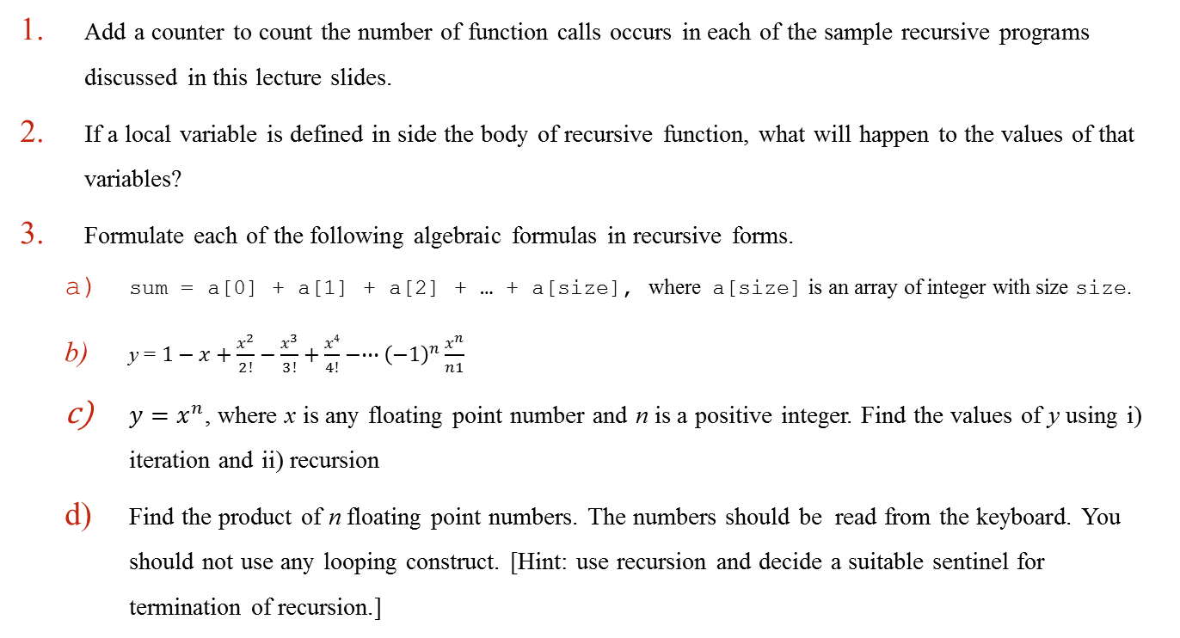
Problems to Ponder…
Add a counter to count the number of function calls occurs in each of the sample recursive programs discussed in this lecture slides.
If a local variable is defined in side the body of recursive function, what will happen to the values of that variables?
Formulate each of the following algebraic formulas in recursive forms.
  sum = a[0] + a[1] + a[2] + … + a[size], where a[size] is an array of integer with size size.
  y = $1−x+\frac{x^{2}}{2!}−\frac{x^{3}}{3!}+\frac{x4}{4!}−∙∙∙{\left(−1\right)}^{n}\frac{x^{n}}{n1}$
  $y=x^{n}$, where x is any floating point number and n is a positive integer. Find the values of y using i) iteration and ii) recursion
  Find the product of n floating point numbers. The numbers should be read from the keyboard. You should not use any looping construct. [Hint: use recursion and decide a suitable sentinel for termination of recursion.]

Slide 39
Problems for Practice…
You can check the Moodle course management system for a set of problems for your own practice.
  Login to the Moodle system at http://cse.iitkgp.ac.in/
  Select “PDS Spring-2017 (Theory) in the link “My Courses”
  Go to Topic 6: Practice Sheet #06 : Recursion in C
Solutions to the problems in Practice Sheet #06 will be uploaded in due time.

Slide 40
  If you try to solve problems yourself, then you will learn many things automatically.
  Spend few minutes and then enjoy the study.

